Slide 1
The Problem
Each loaded page in the browser is a different scope
We want to store data to “remember” states and information in general so we can use it later or across pages (stateless API)
We need this information to be accessible “later”
Example: remembering last visit, storing some preferences, knowing if a user authenticated earlier before showing some information.

Slide 2
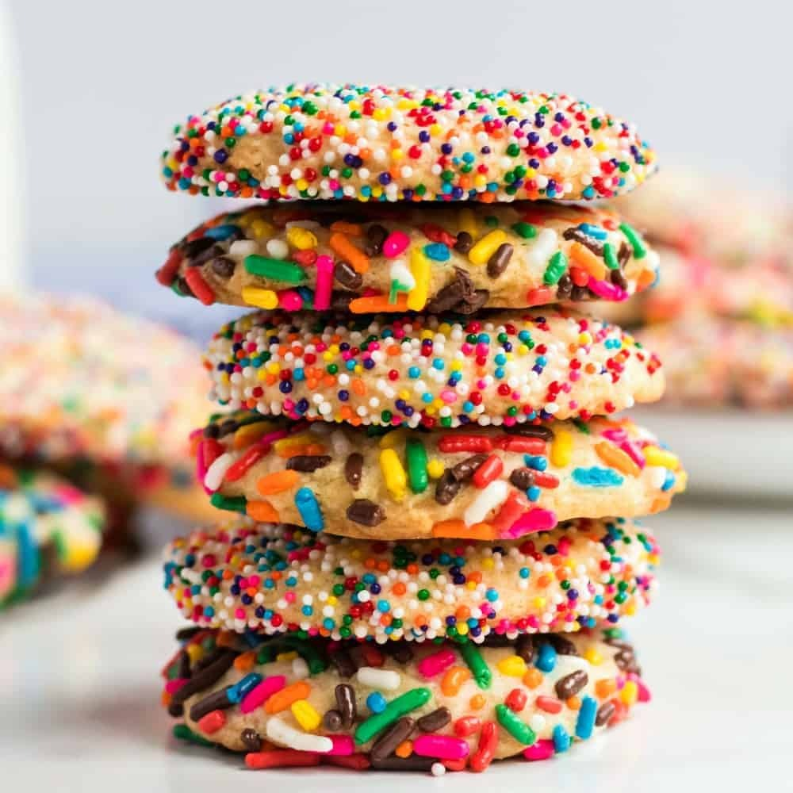
Cookies

Slide 3

Cookie are a small file with the maximum size of 4KB that the web server stores on the client computer.
Http is a stateless protocol, and that once you navigate to a new URL, all scope variables disappear.
Cookies can store data in the browser and retrieve it later from another page
A cookie created by a user can only be visible to them.
A cookie contains the information as a string generally in the form of a name-value pair separated by semi-colons.
Important note: cookies are attached to a domain: that means a program can only read the cookies it created
Cookie format
“email=alaadam0@gmail.com;username=alaadam”

Slide 4

Cookie life
Client
Response
Server
Html/JS/CSS
App.js
Request

Slide 5

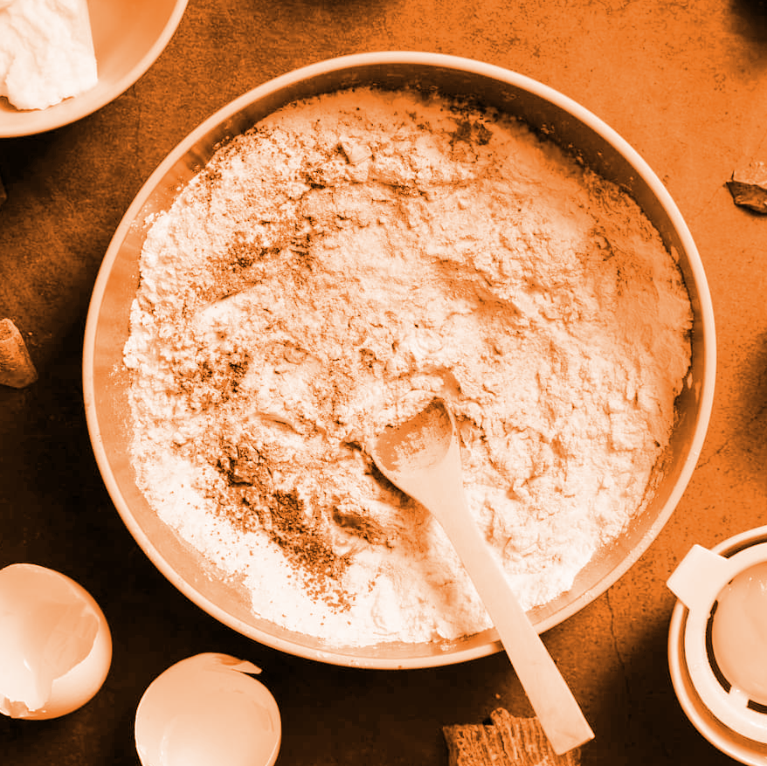
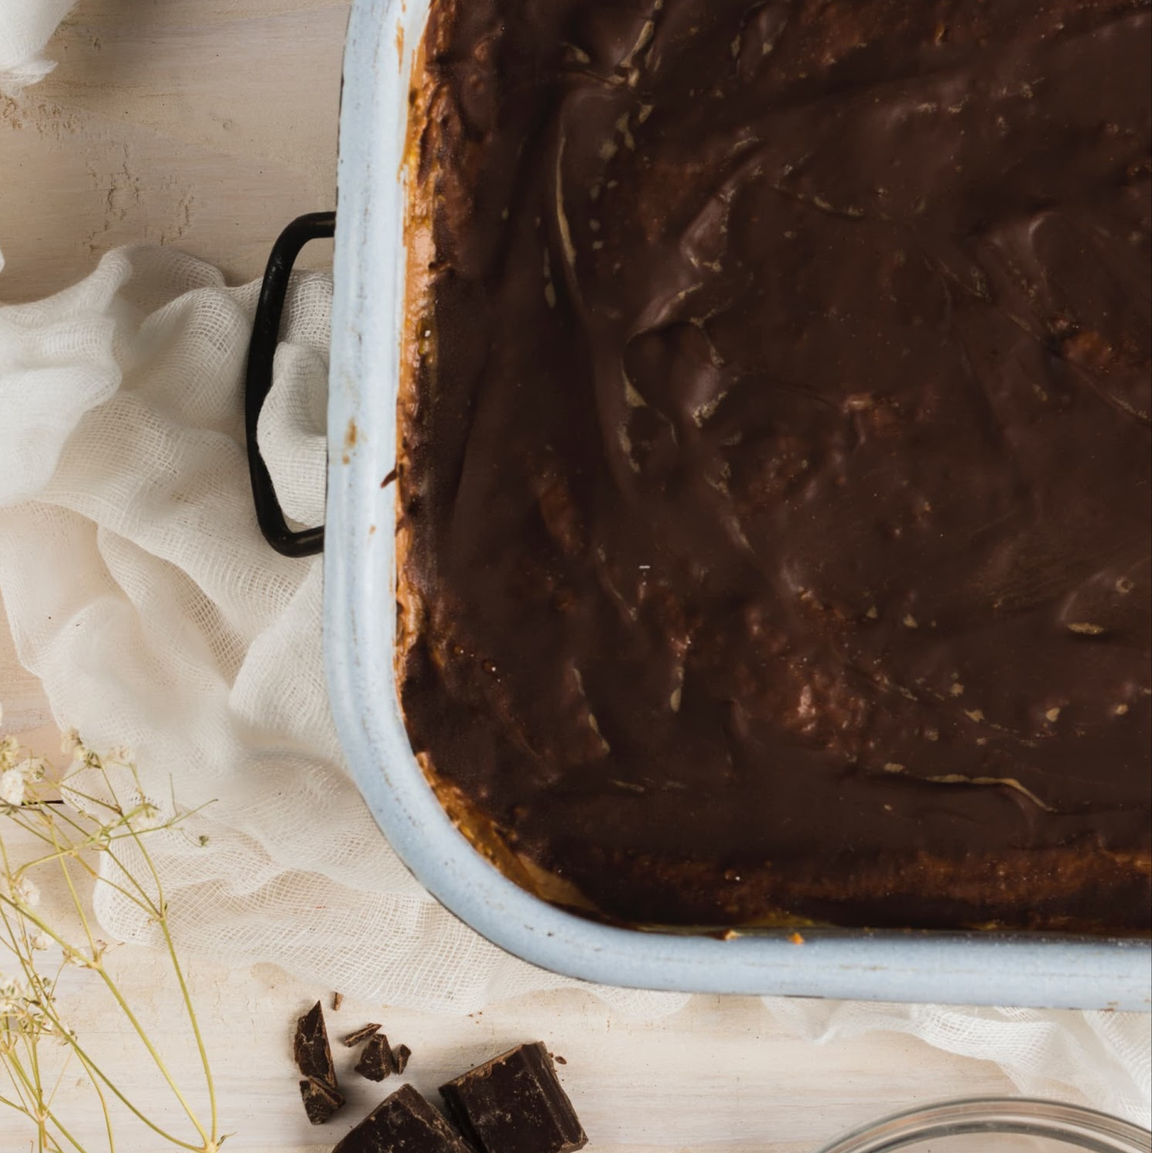
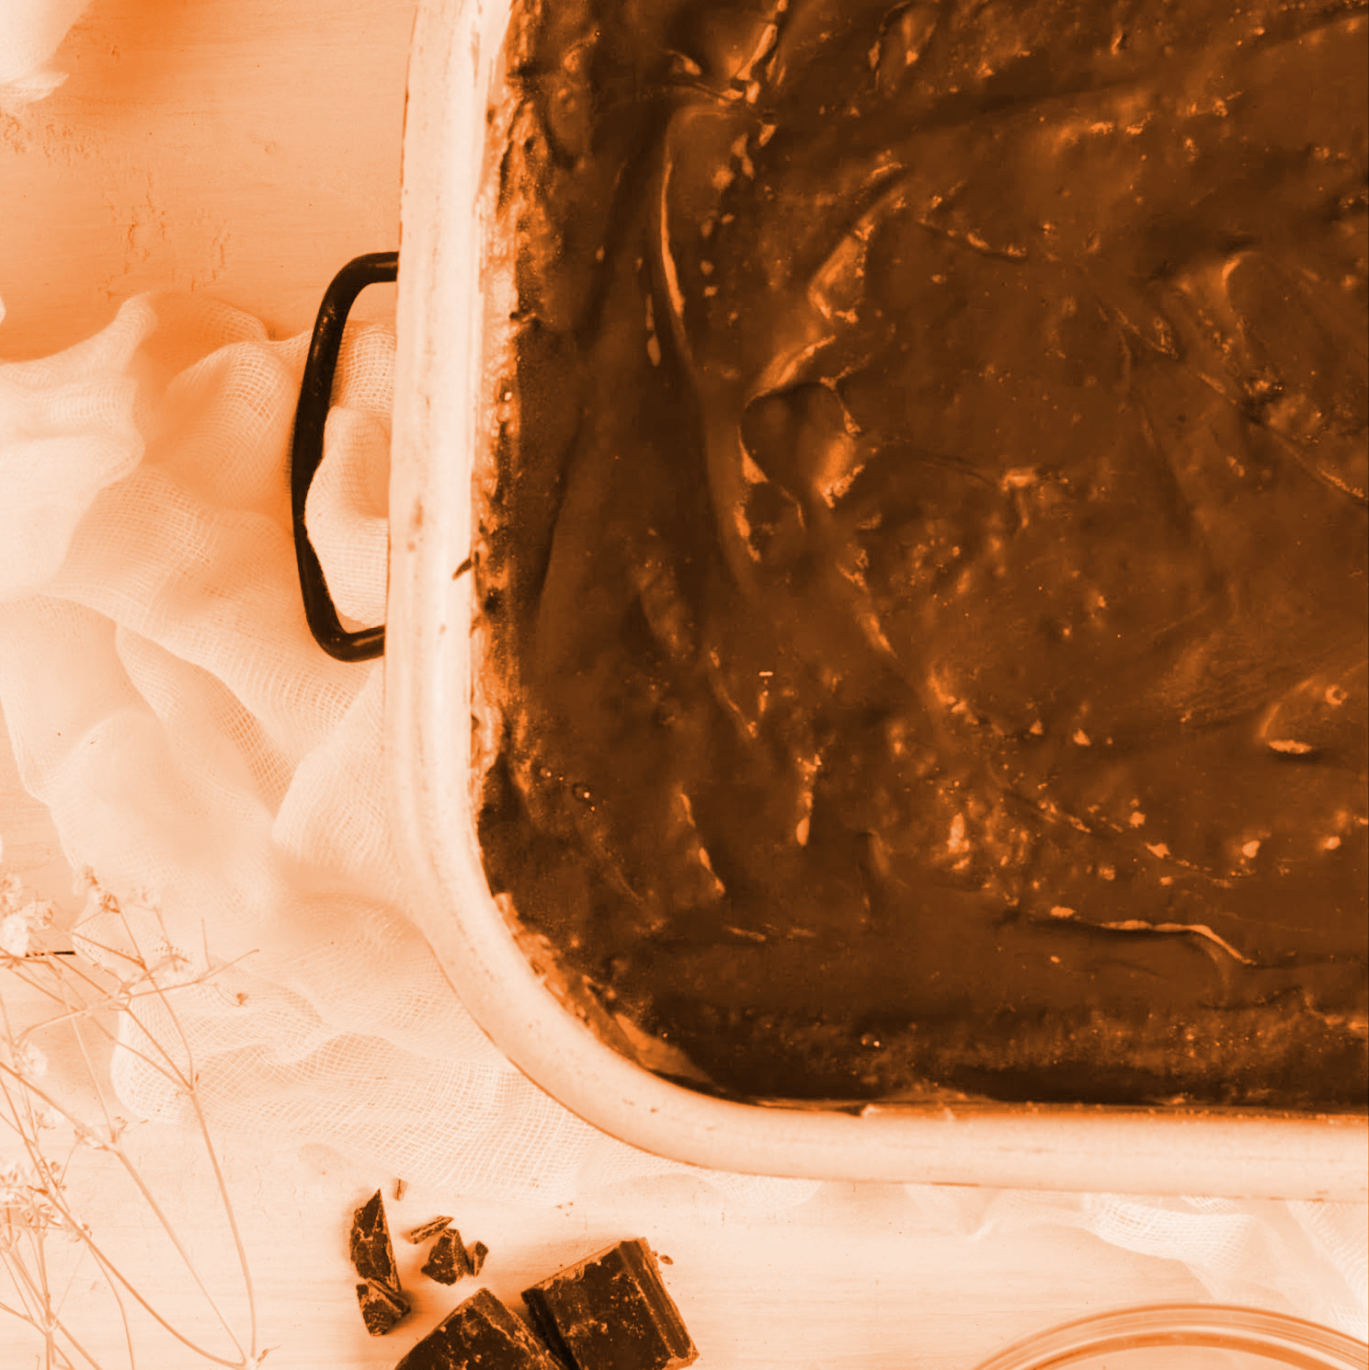


Cookie Facts
Secruity
Privacy
Delete
Cookies are used for non-sensitive information because the cookies file is readable on your computer
Cookies are private to each website / domain
You can manually delete cookies in your browser

Slide 6
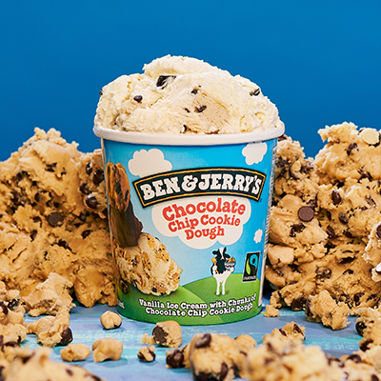
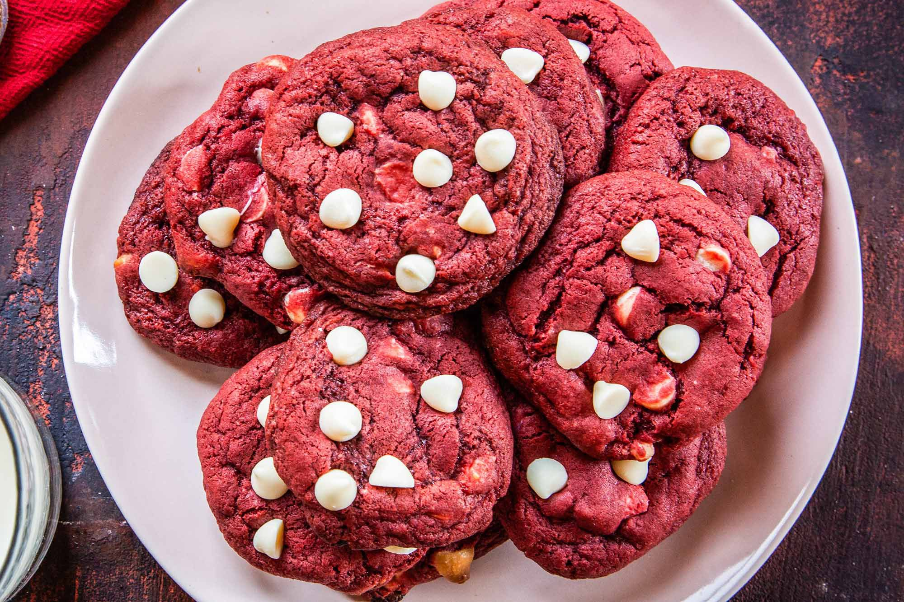
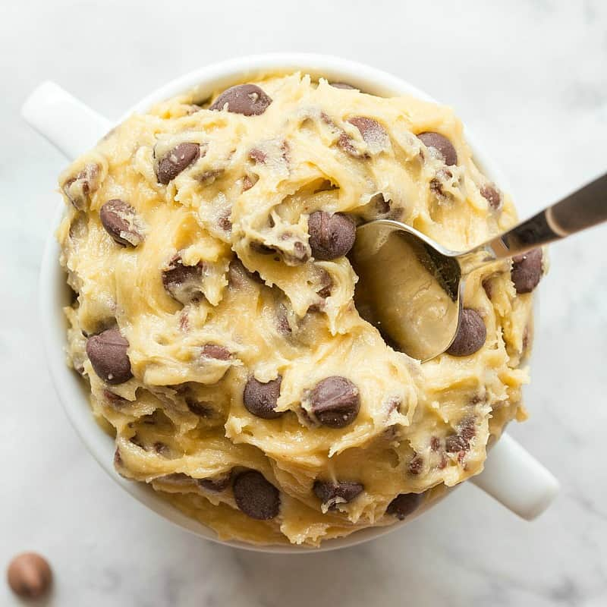
Cookie Facts
Expiration
Size
Client-Server
Cookies can have an expiration date: these will be automatically erased at the expiration date
Cookies length is limited; it cannot be used to store long information
Cookies can be created, read and updated on the client side and on the server

Slide 7



Lets bake some cookies!

